Slide 1
LAB 1: Introduction to A.I.
Done by,
Name: K Jivitesh Narayan
Reg. No: 2022176030
Date: 13 Oct 2022

Slide 2
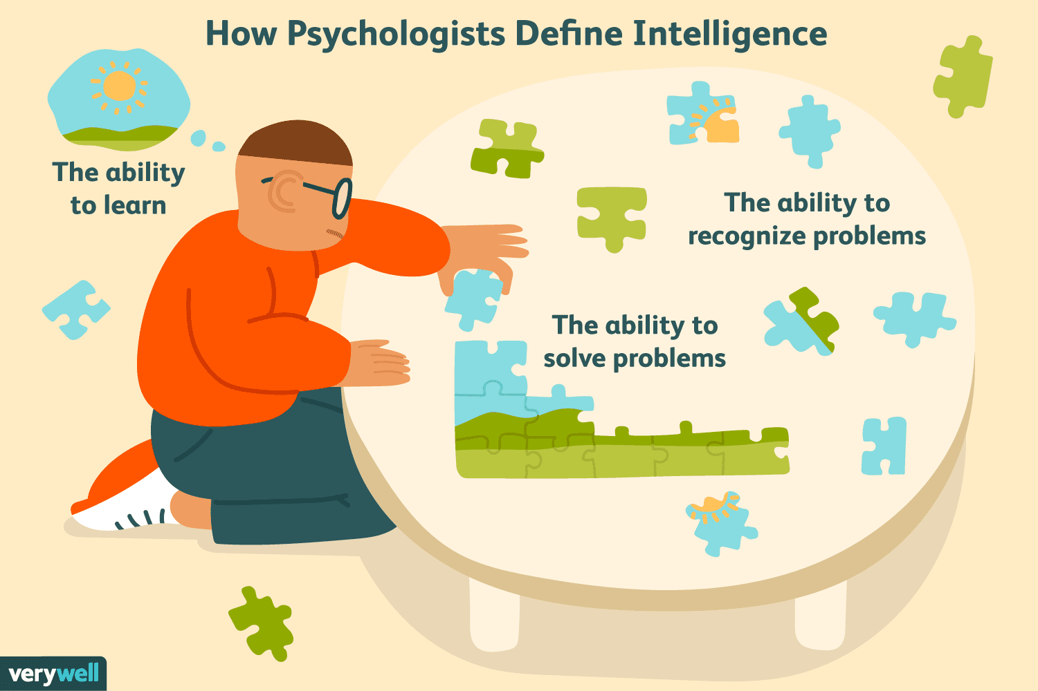
What is Intelligence?
Intelligence is the ability to acquire and apply knowledge and skills.

Slide 3
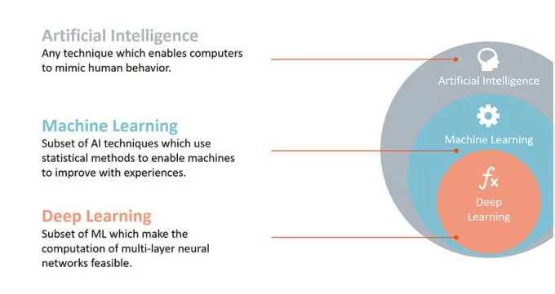
What is Artificial Intelligence?
Artificial Intelligence is the simulation of human intelligence processes by machines.

Slide 4
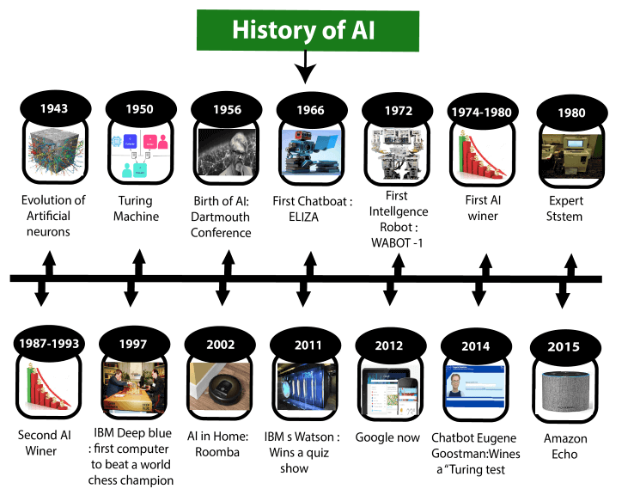
History of AI
Some important milestones are:
Year 1943: The first work which is now recognized as AI was done by Warren McCulloch and Walter pits in 1943. They proposed a model of artificial neurons.
Year 1966: The researchers emphasized developing algorithms which can solve mathematical problems. Joseph Weizenbaum created the first chatbot in 1966, which was named as ELIZA.
In the Year 1980, the first national conference of the American Association of Artificial Intelligence was held at Stanford University.
Year 1997: In the year 1997, IBM Deep Blue beats world chess champion, Gary Kasparov, and became the first computer to beat a world chess champion.

Slide 5
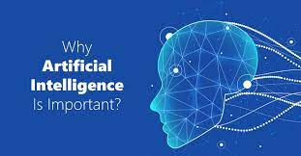
Importance of AI?
AI is important because:
AI enables organizations to make better decisions, improving core business processes by increasing the speed and accuracy of strategic decision-making processes.
AI can do jobs that are deemed too dangerous for humans to do.
AI is the key for a better society in the future.

Slide 6
Advantages and Disadvantages of AI
Advantages:
AI is better than humans
AI is available at all times
AI is cheaper, more accurate and more efficient than humans
Disadvantages:
AI is replacing human jobs and shifting power from workers to owners.
For dynamic environments, the AI has to be updated in a regular time period. Therefore, the engineering cost of AI in the long term is expensive.
Developing ethical AI requires a huge amount of correct data, which is hard to acquire.

Slide 7
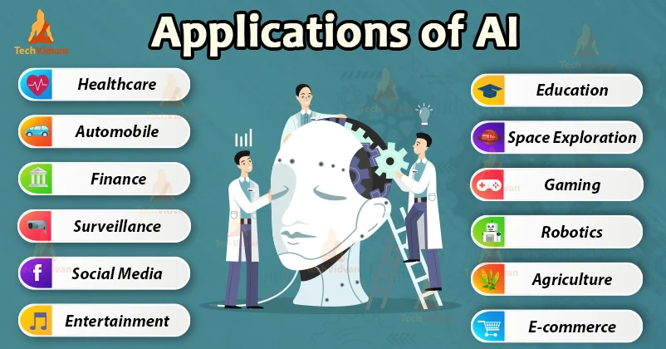
Applications of AI
Here are some Applications of AI:
Ecommerce
Personalized Shopping
Fraud detection
AI-powered Assistants
Education
Automating administrative tasks to help educators
Creating Content
Personalized Learning
Voice Assistants
Lifestyle
Autonomous Vehicles
Spam filters
face recognition
Recommendation systems

Slide 8
THANK YOU

